Slide 1


Weather & Rainfall Analysis using Machine Learning Model

Slide 2

Learning Objectives
Understand how rainfall prediction can assist in agriculture, water resource management, and disaster prevention.
Apply data preprocessing, visualization, and machine learning techniques.
Build and evaluate predictive models for rainfall forecasting.
Gain hands-on experience with Python libraries (Pandas, NumPy, Scikit-learn, Matplotlib).
Enhance problem-solving & analytical thinking.
GOAL
Source :
www.freepik.com/

Slide 3
Tools and Technology used
Programming Language :- Python
Libraries & Frameworks:-
Development Environment:-
Version Control & Collaboration:-
Pandas – Data manipulation and cleaning.
NumPy – Numerical computations and array operations.
Matplotlib & Seaborn – Data visualization and plotting.
Scikit-learn – Machine learning model building and evaluation.
Jupyter Notebook – Interactive environment for coding, testing, and visualization
VS Code – Lightweight IDE for project development and version control integration.
Git – Tracks changes, branching, and merging code efficiently.
GitHub – Repository hosting, collaboration, and project documentation.

Slide 4
Methodology
Data Collection & Exploration:-Collected historical weather datasets containing rainfall records, explored their structure, and identified key features relevant for prediction.
Data Preprocessing:-Cleaned the dataset by handling missing values, scaling data for uniformity, and engineering features to prepare it for modeling.
Exploratory Data Analysis (EDA) – Performed statistical analysis and created visualizations to uncover rainfall patterns, seasonal trends, and correlations among weather parameters.
Model Building – Trained and tested multiple machine learning models (Logistic Regression, Decision Tree, Random Forest) to develop an accurate rainfall prediction system.
Model Evaluation – Assessed model performance using metrics such as accuracy, precision, recall, F1-score, and confusion matrix to determine the most effective model.

Slide 5
Problem Statement:
Rainfall plays a crucial role in agriculture, water resource management, and disaster preparedness, yet its unpredictable nature makes planning extremely difficult. Farmers often struggle with crop failures due to unexpected droughts or floods, while city planners face challenges in managing water supply and preventing urban flooding.
Traditional forecasting methods rely heavily on manual observations or basic statistical techniques, which are often inaccurate, fail to capture complex weather patterns, and cannot adapt to changing climate conditions. As a result, there is an urgent need for more reliable, data-driven rainfall prediction systems that can analyze large volumes of weather data and provide timely, accurate forecasts.
Without accurate rainfall prediction, stakeholders—including farmers, policymakers, and disaster management authorities—lack the necessary insights to make informed decisions. This leads to economic losses, food insecurity, poor water management, and increased vulnerability to natural disasters.
Therefore, the problem lies in the absence of an effective and efficient predictive system that leverages modern machine learning techniques to forecast rainfall with higher accuracy and reliability

Slide 6
Solution:
The proposed Rainfall Prediction System uses machine learning to provide accurate and timely rainfall forecasts.
Historical weather data (temperature, humidity, wind speed, pressure) is collected and preprocessed.
Exploratory Data Analysis (EDA) helps identify key patterns influencing rainfall.
Machine learning models such as Logistic Regression, Decision Tree, and Random Forest are trained and optimized for prediction.
The system offers data-driven insights that support:
1. Farmers in crop and irrigation planning.
2. City planners in water resource management.
3. Disaster authorities in flood preparedness.
This solution transforms raw weather data into reliable, actionable forecasts, helping reduce risks and improve decision-making.

Slide 7
Screenshot of Output:

Slide 8
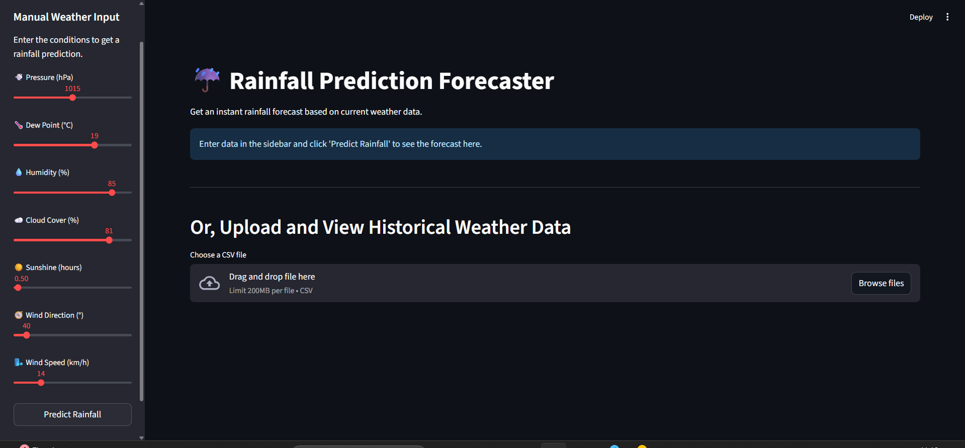
Screenshot of Output:

Slide 9
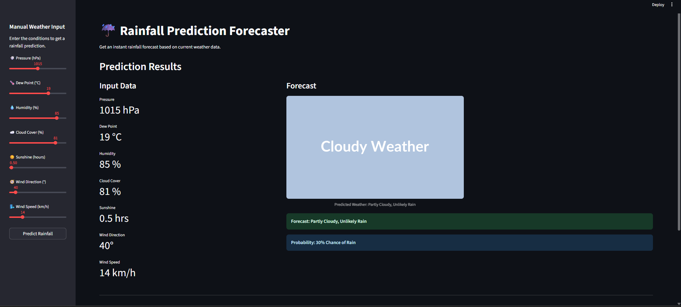
Screenshot of Output:

Slide 10
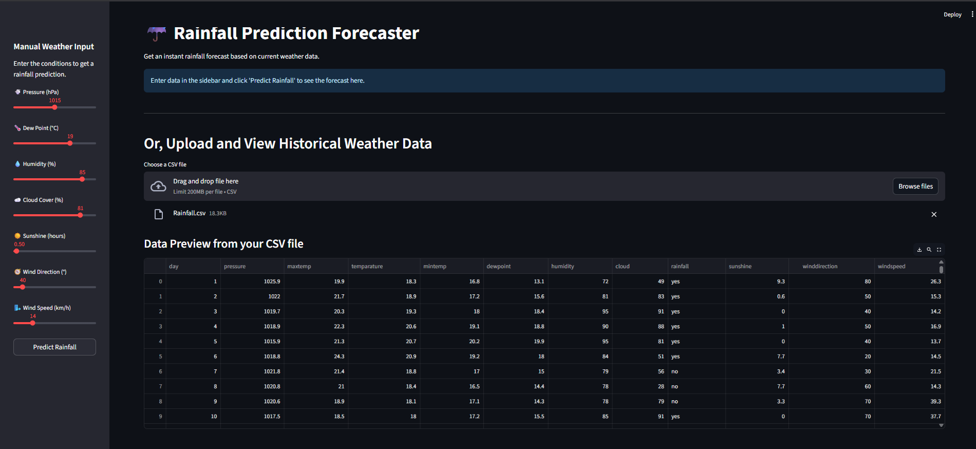
Screenshot of Output:

Slide 11
Conclusion:
The Rainfall Prediction System demonstrates how machine learning can be applied in climate analytics.
Predictive accuracy improves decision-making in agriculture, water management, and disaster risk reduction
Future scope: Enhance with deep learning models and real-time weather API integration.

